Slide 1
13 July 2016 To: Raleigh Stormwater Inspections Section From: Springdale Estates Lake Committee Re: Illicit Discharge into Hare Snipe Creek Tributary from Reserve at Grayson on 13 July 2016 Dear Raleigh Stormwater Inspection Service: Today we conducted our biweekly volunteer stream monitoring of the Tributary of Hare Snipe Creek. At the monitoring site, the water had a JTU of 20. Then we went upstream to take the upstream temperature for calculating the temperature difference and were dismayed to find that the water upstream was milky white. Clearly something had been dumped into the tributary and was now working its way downstream but had not yet reached our monitoring site. We have under refrigeration 10-15 ml samples of the milky white water and also the non-milky water from the sampling site. Please let us know if you would like to have these samples. The figures illustrate the milky discharge originating at the outlet from the Reserve at Grayson (Figure 1) and the progression downstream (Figures 4 and 5). Figure 2 shows a bucket that might be the source of the discharge. Figure 3 shows the volunteer monitoring site before the milky discharge reached it. We would appreciate your looking into this. Sincerely, Van Cotter for The Springdale Estates Lake Committee p.s. We were delighted to find salamanders in the Tributary today but are concerned of what impact this milky discharge will have on them.

Slide 2
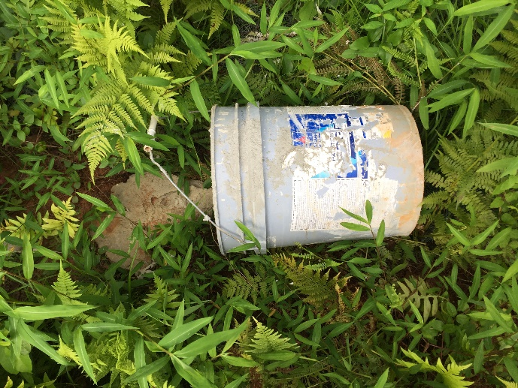
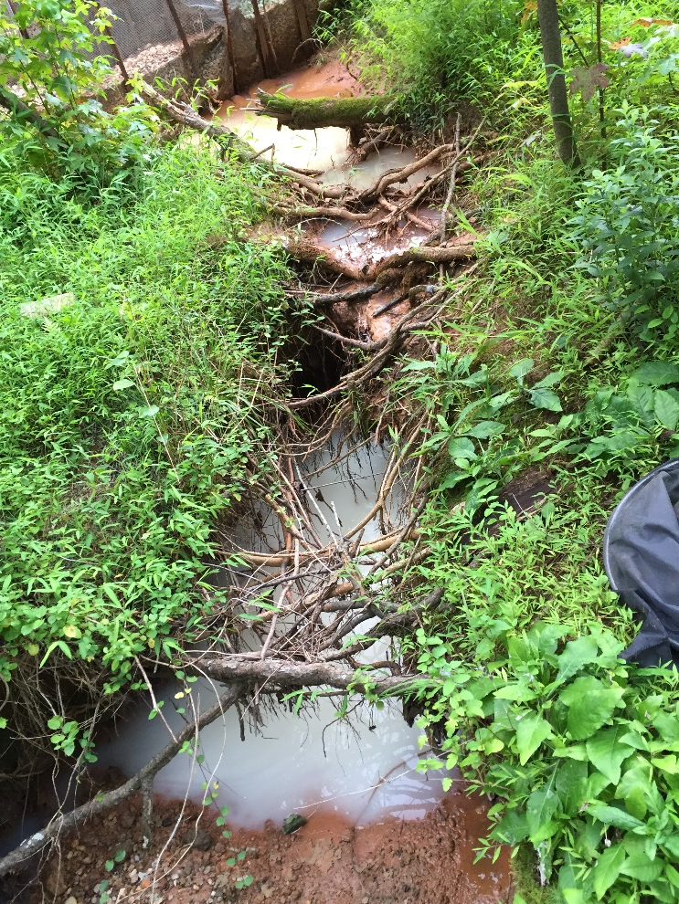
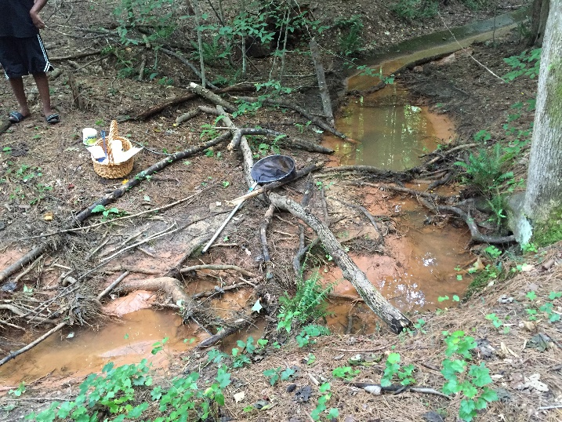
Outflow from Reserve at Grayson
Figure 2. 13 July 2016 Bucket discarded in riparian zone along Tributary of Hare Snipe Creek at the outlet from Reserve at Grayson. This perhaps was the source of the milky discharge.
Bucket was located to the left of the frame of Figure 1 and we left it in place undisturbed.
Figure 1. 13 July 2016 6:31 pm
Milky water in Tributary of Hare Snipe. Outflow from Reserve at Grayson
Figure 3. 13 July 2016 6:25 pm
Volunteer Stream Monitoring Site - Tributary of Hare Snipe. Milky discharge had not yet reached this point.

Slide 3
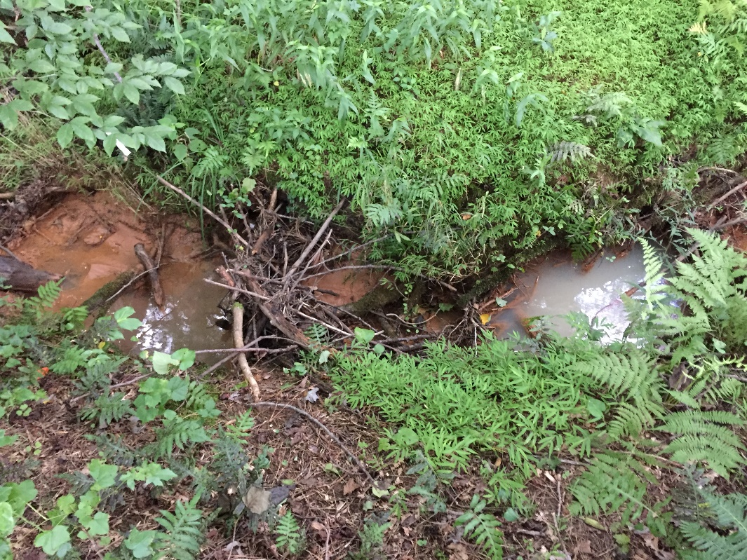
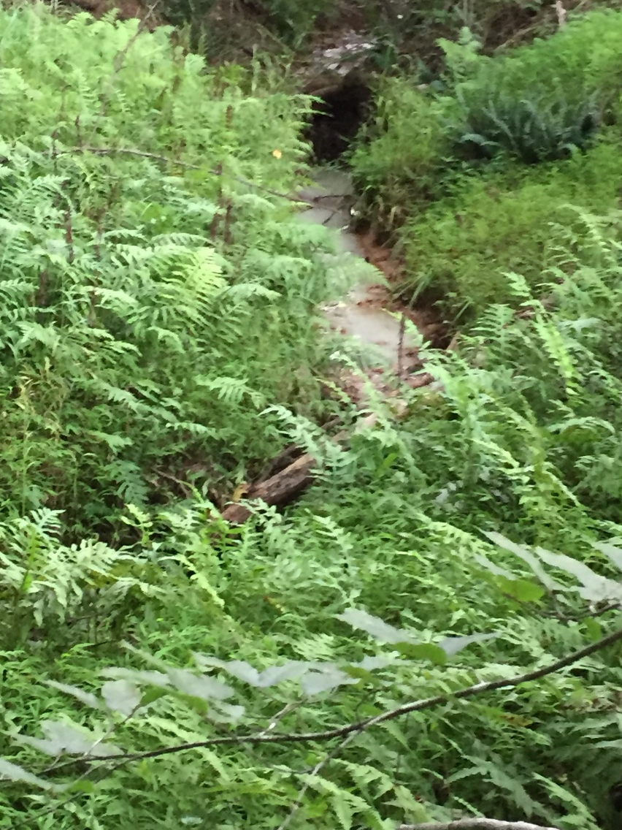
Figure 5. 13 July 2016 6:42 pm
View further downstream. Milky water had reached this point on its way downstream. Flow is from right to left. Monitoring site is downstream to the left and outflow from Reserve at Grayson is upstream to the right.
Figure 4. 13 July 2016
View downstream from the outlet from Reserve at Grayson showing the milky discharge headed downstream.

